Slide 1

Air Visualizations in R
Brandyn Ruiz

Slide 2
Previous Projects
CASPER - WCWLB
Dr. Elizabeth Kamai and Dr. Jill Johnston
https://envhealthcenters.usc.edu/2023/03/casper-neighborhood-health-project.html
Rule 1180 – Hydrogen Sulfide
Dr. Arbor Quist and Dr. Jill Johnston
https://envhealthcenters.usc.edu/infographics/infographic-hydrogen-sulfide-and-health
Notes:
Emphasis on gap in data interpretation and visualization tools regarding sensor explosion; need better tools
What is the motivation behind use –
*Goods movement corridor from port to railyard
2 slides – LA air pollution; AB 617 with map of community (include lots of maps!)
Located in the Los Angeles Basin, the city is surrounded by mountains that trap air pollution, and also cause marine temperature inversion in the summer months. The cool ocean air from the Pacific that is closer to the surface gets trapped by warmer air in the Great Basin and Inland Empire, preventing polluted air from escaping into the atmosphere. This is usually visible in the summer haze that seems to blanket the skyline of downtown Los Angeles. The two major pollutants that contribute to air pollution are PM2.5 and ozone.
Add sources (traffic, ports, trucks, etc)
Move content from this slide into script

Slide 3
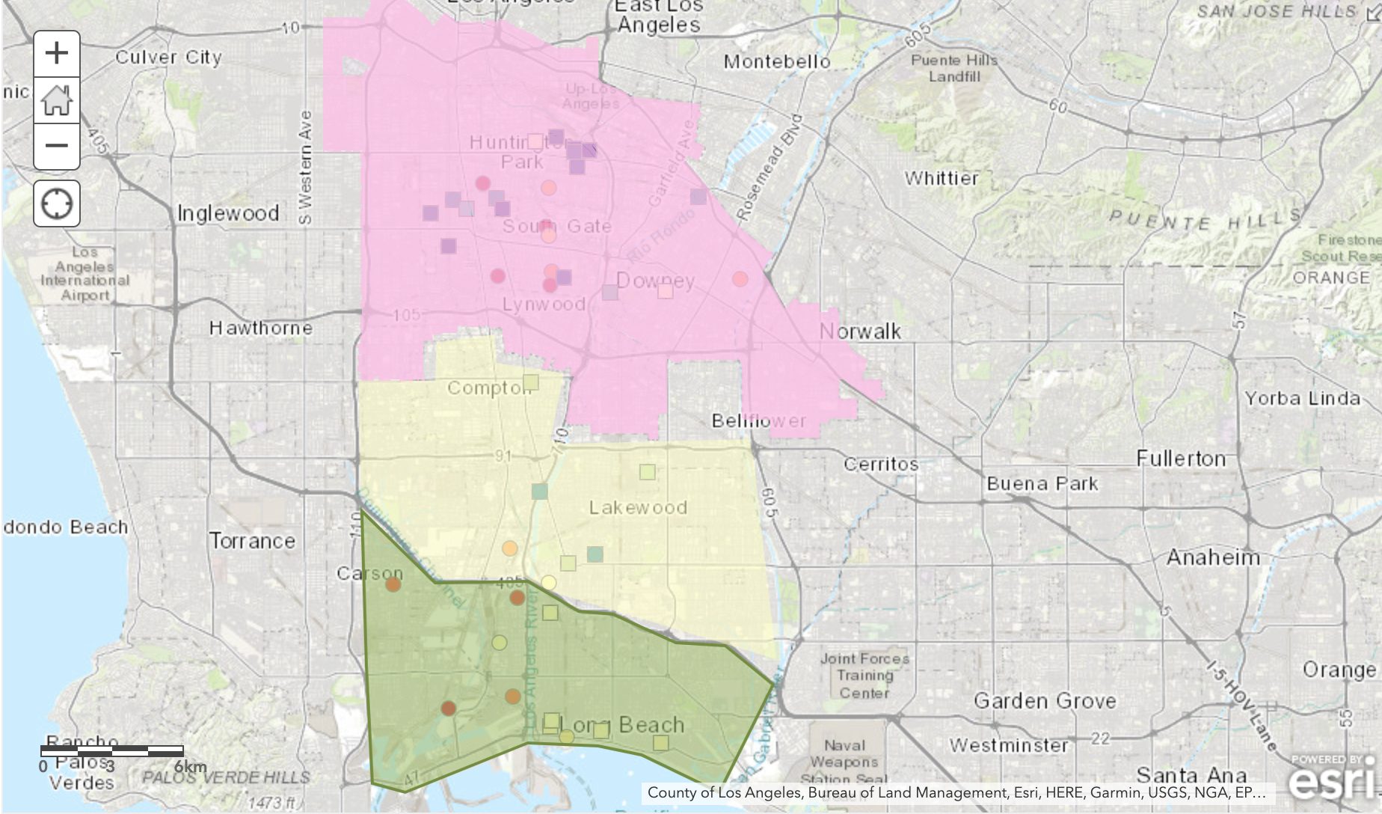
CASPER - WCWLB
Neighborhoods along the international freight movement from the Ports of LA and Long Beach to railyard
Sources include trucks, ships, railyards, refineries
710 freeway
Notes:
CF_1 uses the "average particle density" for indoor particulate matter and CF_ATM uses the "average particle density" for outdoor particulate matter
PAS = PurpleAir Synoptic data; A pas object is just a large dataframe with 44 data columns and a record for each PurupleAir sensor channel (2 channels per sensor)
PAT = PurpleAir Time Series data; pat contains two dataframes, meta and data. The meta dataframe contains metadata of the selected PurpleAir sensor – this includes non-time series data such as location information, labels, etc. The data dataframe contains datestamped sensor readings of PM2.5, temperature, humidity, and other pertinent sensor data.
Screenshot of R package documentation
Have an objective/aim -- what is the purpose of all of this

Slide 4
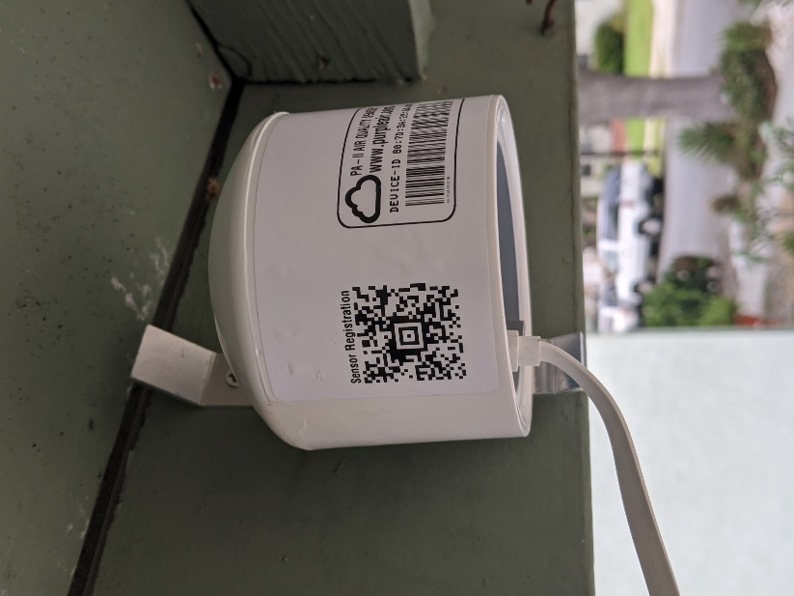
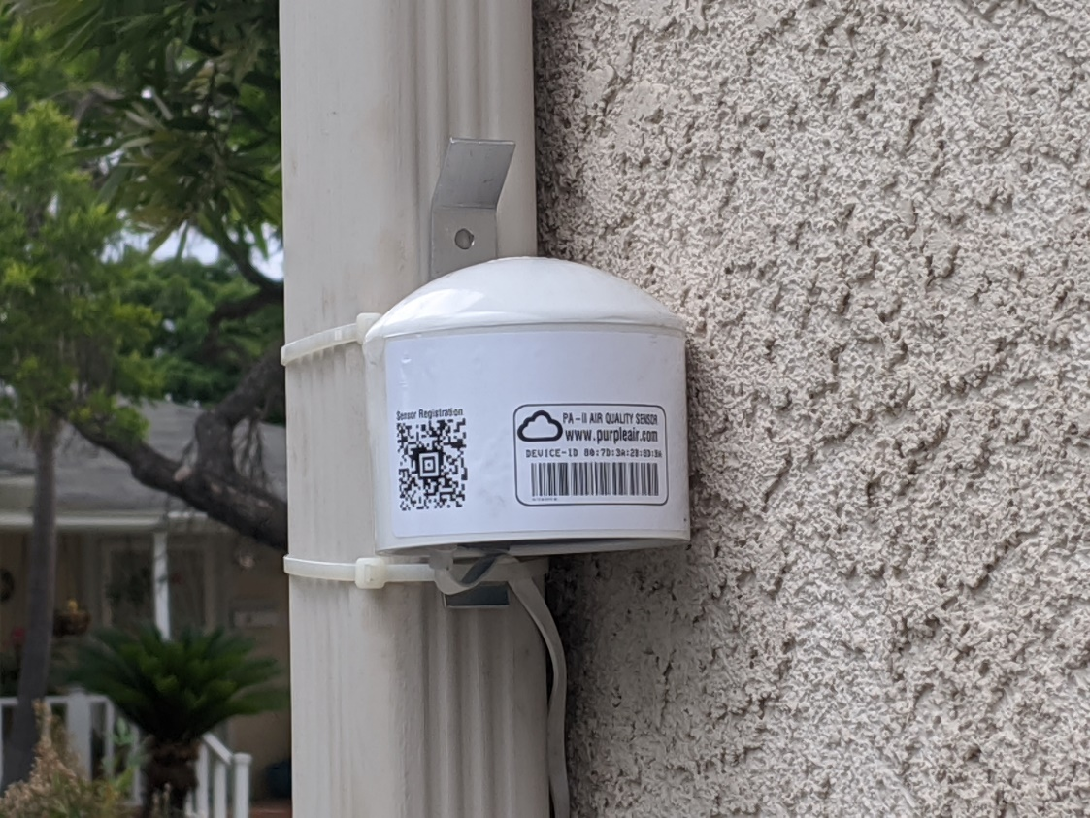
PurpleAir (PA) Monitors
Low-cost sensors that use PMSX003 laser counters to measure particulate matter in real time
Outdoor PA-II sensors read PM2.5 in µg/m³
Laser counters alternate 5-second readings averaged over 120 seconds
PA sensor readings uploaded to cloud every 120 seconds
Historic data stored in PA's Thingspeak database
Photo credits: Jennifer Lentz
Notes:
PurpleAir sensor readings are uploaded to the cloud every 120 seconds where they are stored for download and display on the PurpleAir website. After every interval, the synoptic data is refreshed and the outdated synoptic data is then stored in a ThingSpeak database.
CF_1 uses the "average particle density" for indoor particulate matter and CF_ATM uses the "average particle density" for outdoor particulate matter
Picture of air monitor

Slide 5
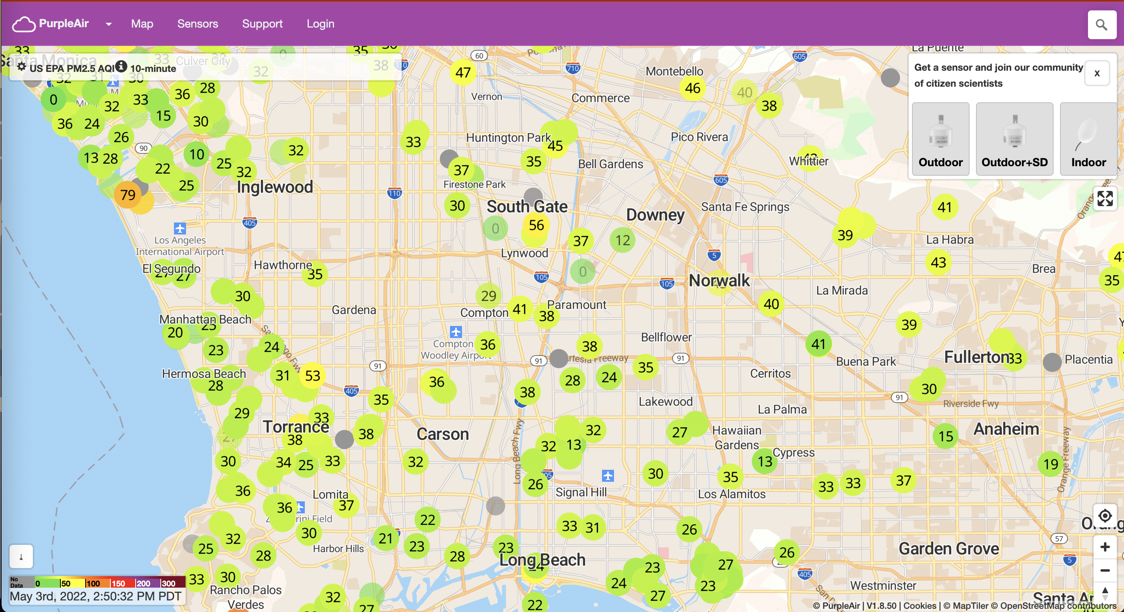
PurpleAir
Image source: https://map.purpleair.com/1/m/i/mAQI/a10/p604800/cC0?select=26955#11.66/33.9798/-118.2868
Notes:
CF_1 uses the "average particle density" for indoor particulate matter and CF_ATM uses the "average particle density" for outdoor particulate matter
PAS = PurpleAir Synoptic data; A pas object is just a large dataframe with 44 data columns and a record for each PurupleAir sensor channel (2 channels per sensor)
PAT = PurpleAir Time Series data; pat contains two dataframes, meta and data. The meta dataframe contains metadata of the selected PurpleAir sensor – this includes non-time series data such as location information, labels, etc. The data dataframe contains datestamped sensor readings of PM2.5, temperature, humidity, and other pertinent sensor data.
Screenshot of R package documentation
Have an objective/aim -- what is the purpose of all of this

Slide 6
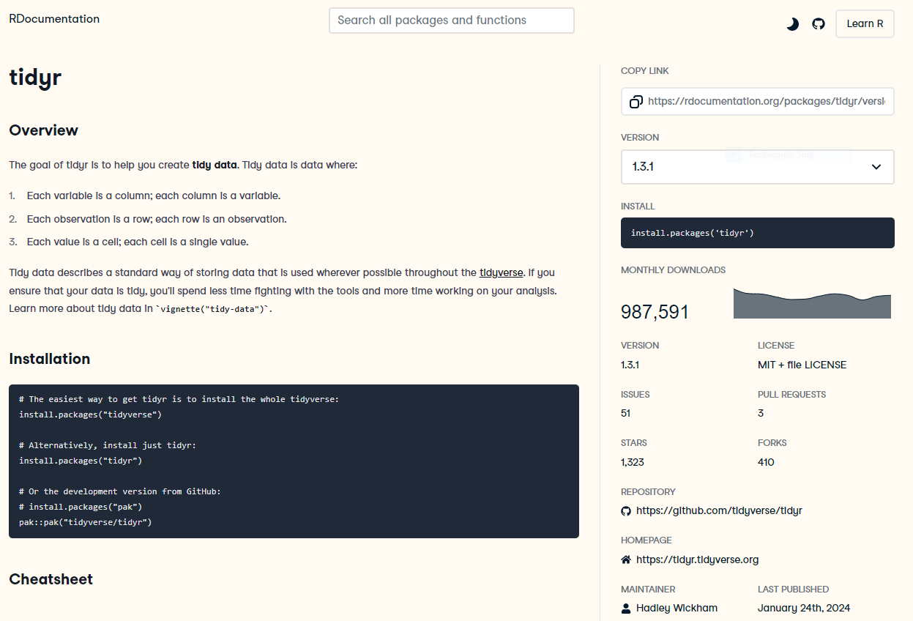
Data Analysis in R
Image source:https://www.rdocumentation.org/packages/tidyr/versions/1.3.1
Notes:
Deciding what data to use
How to communicate data – list community groups earlier, what sort of information they wanted and how they wanted it
Show current drafts
Emphasize community aspect over technical
Selection criteria, show data at annual scale – data thresholds (highlight decision criteria rather than tools) -- reliability/completeness criteria = 1 slide
Also talk about QC of data – basic cleaning of data for presentation purposes
Show picture of corridor or map of area (# of sensors available increasing year by year)

Slide 7
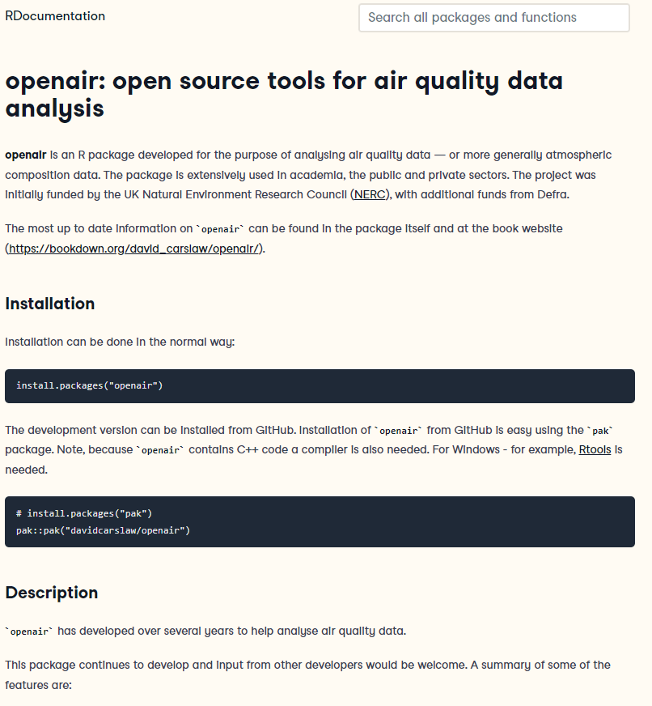
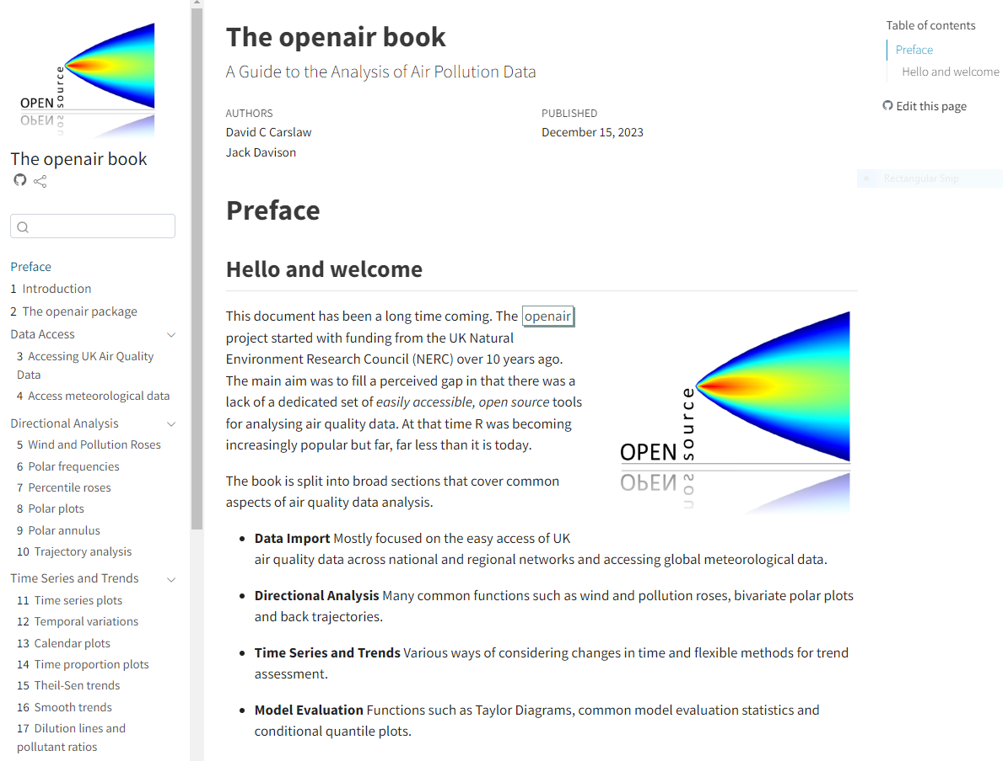
Data Analysis in R
Image source:https://www.rdocumentation.org/packages/openair/versions/2.18-2
Notes:
Deciding what data to use
How to communicate data – list community groups earlier, what sort of information they wanted and how they wanted it
Show current drafts
Emphasize community aspect over technical
Selection criteria, show data at annual scale – data thresholds (highlight decision criteria rather than tools) -- reliability/completeness criteria = 1 slide
Also talk about QC of data – basic cleaning of data for presentation purposes
Show picture of corridor or map of area (# of sensors available increasing year by year)

Slide 8
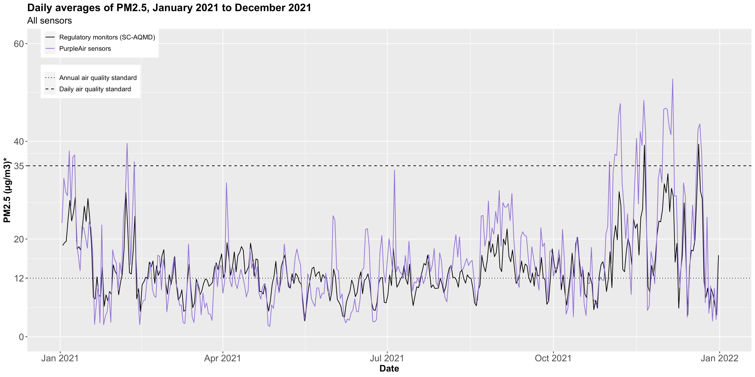
Examining Temporal Trends by Neighborhoods
35
12
Notes:
How to visualize for community use/feedback sessions with focus groups, end result of those discussions
Thumbnails of 4 different plots, highlighting certain feedback (pre and during pandemic)
Show data at neighborhood level rather than individual (both community request and also sensor data completeness issue)
Time-variation plot: How does data vary compared to regulatory monitors
Calendar plot: *wildfires also; What days have the worst air quality?
Percent plot: Percent time exceeding EPA standard

Slide 9
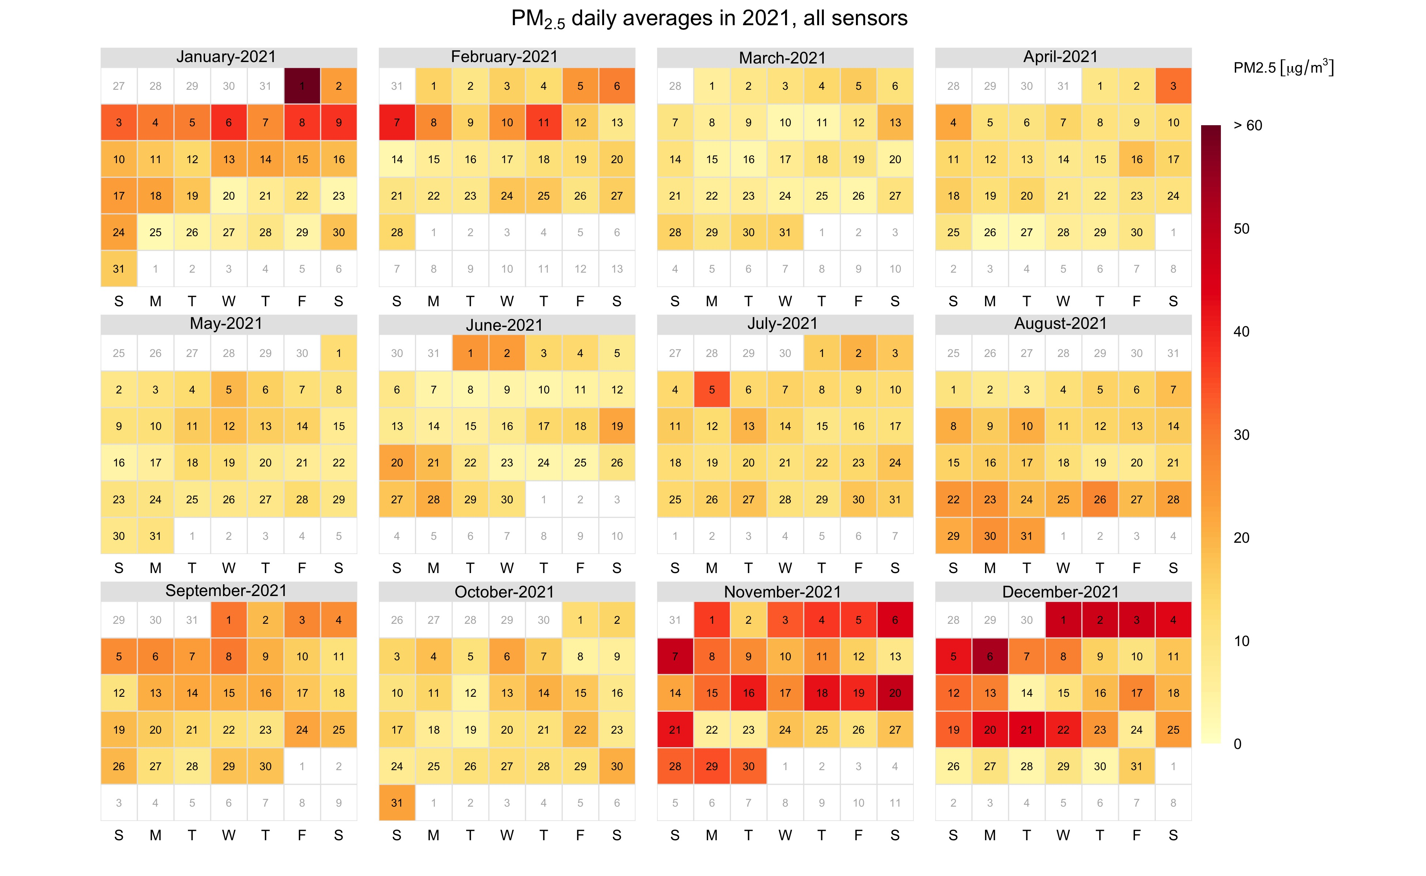
Examining Temporal Trends II
PM2.5 [µg/m3]
> 60
50
40
30
20
10
0
Notes:
How to visualize for community use/feedback sessions with focus groups, end result of those discussions
Thumbnails of 4 different plots, highlighting certain feedback (pre and during pandemic)
Show data at neighborhood level rather than individual (both community request and also sensor data completeness issue)
Time-variation plot: How does data vary compared to regulatory monitors
Calendar plot: *wildfires also; What days have the worst air quality?
Percent plot: Percent time exceeding EPA standard

Slide 10
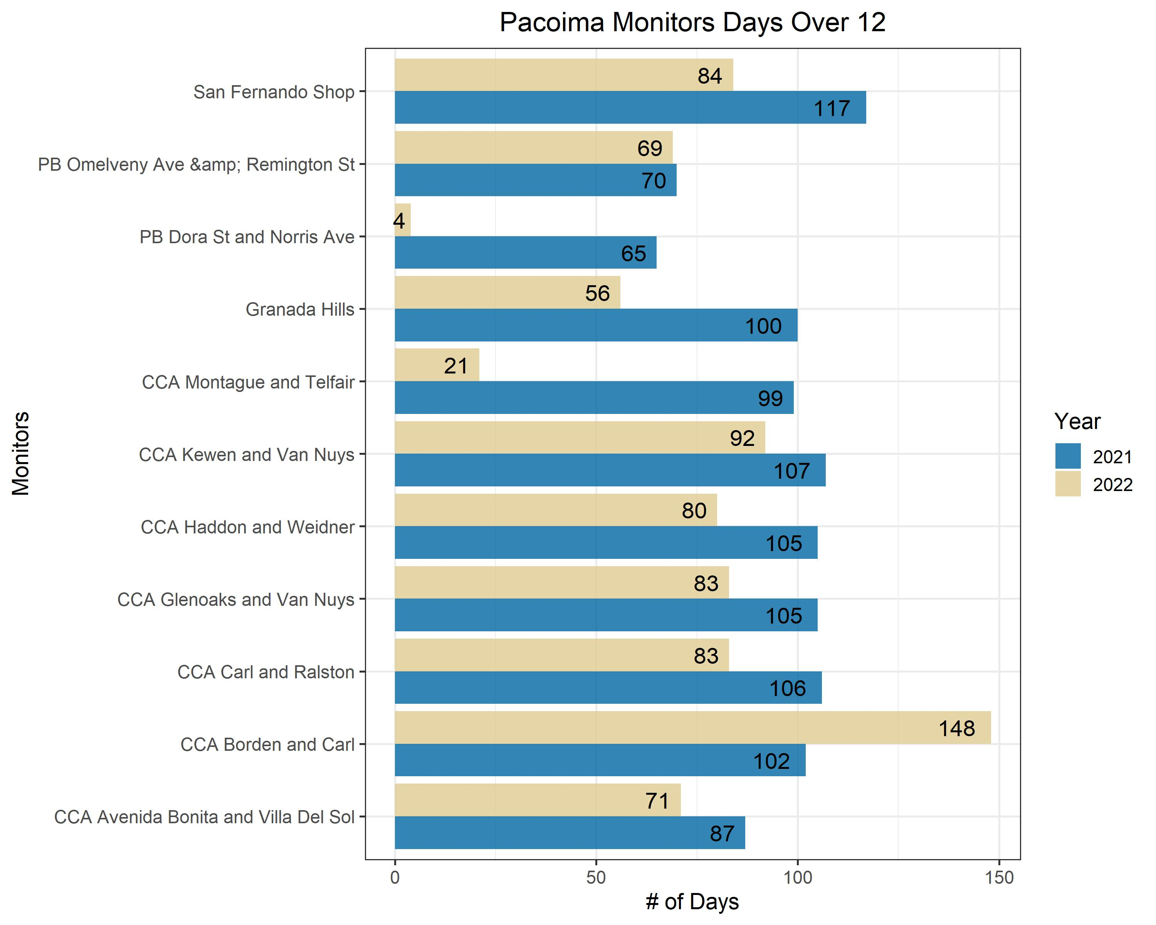
Comparing to Standards
Notes:
How to visualize for community use/feedback sessions with focus groups, end result of those discussions
Thumbnails of 4 different plots, highlighting certain feedback (pre and during pandemic)
Show data at neighborhood level rather than individual (both community request and also sensor data completeness issue)
Time-variation plot: How does data vary compared to regulatory monitors
Calendar plot: *wildfires also; What days have the worst air quality?
Percent plot: Percent time exceeding EPA standard

Slide 11
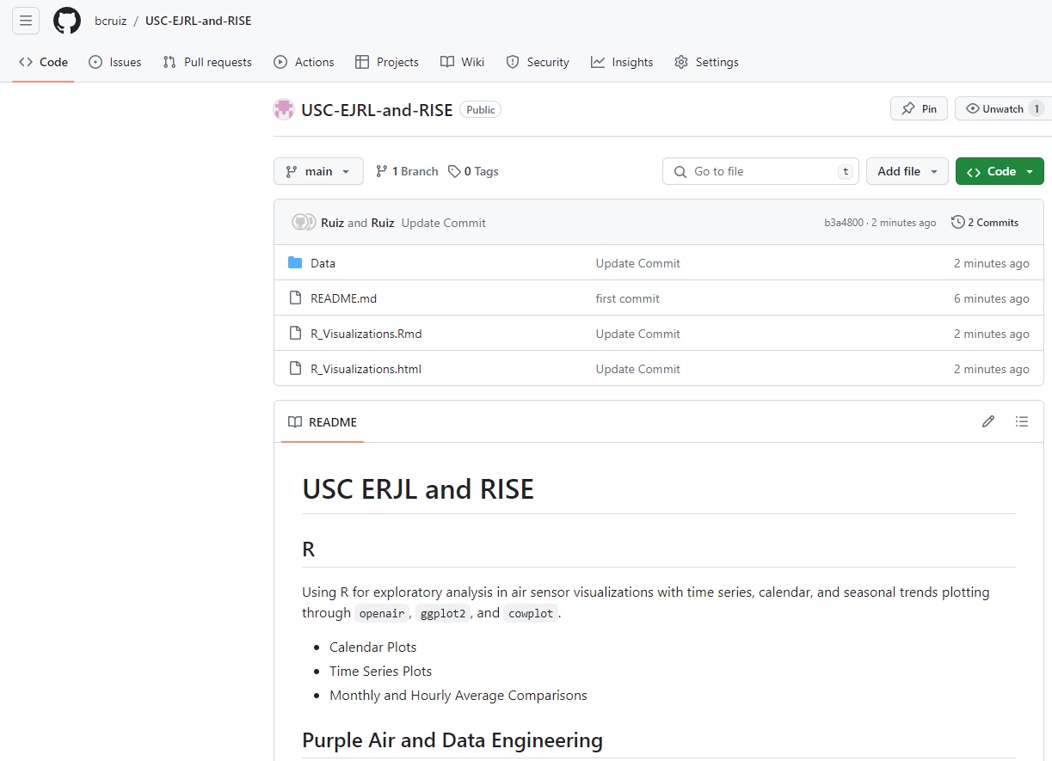
CASPER - WCWLB
Summarized tutorial with r scripts and example data
GitHub Tutorial: https://github.com/bcruiz/USC-EJRL-and-RISE
Notes:
CF_1 uses the "average particle density" for indoor particulate matter and CF_ATM uses the "average particle density" for outdoor particulate matter
PAS = PurpleAir Synoptic data; A pas object is just a large dataframe with 44 data columns and a record for each PurupleAir sensor channel (2 channels per sensor)
PAT = PurpleAir Time Series data; pat contains two dataframes, meta and data. The meta dataframe contains metadata of the selected PurpleAir sensor – this includes non-time series data such as location information, labels, etc. The data dataframe contains datestamped sensor readings of PM2.5, temperature, humidity, and other pertinent sensor data.
Screenshot of R package documentation
Have an objective/aim -- what is the purpose of all of this

Slide 12
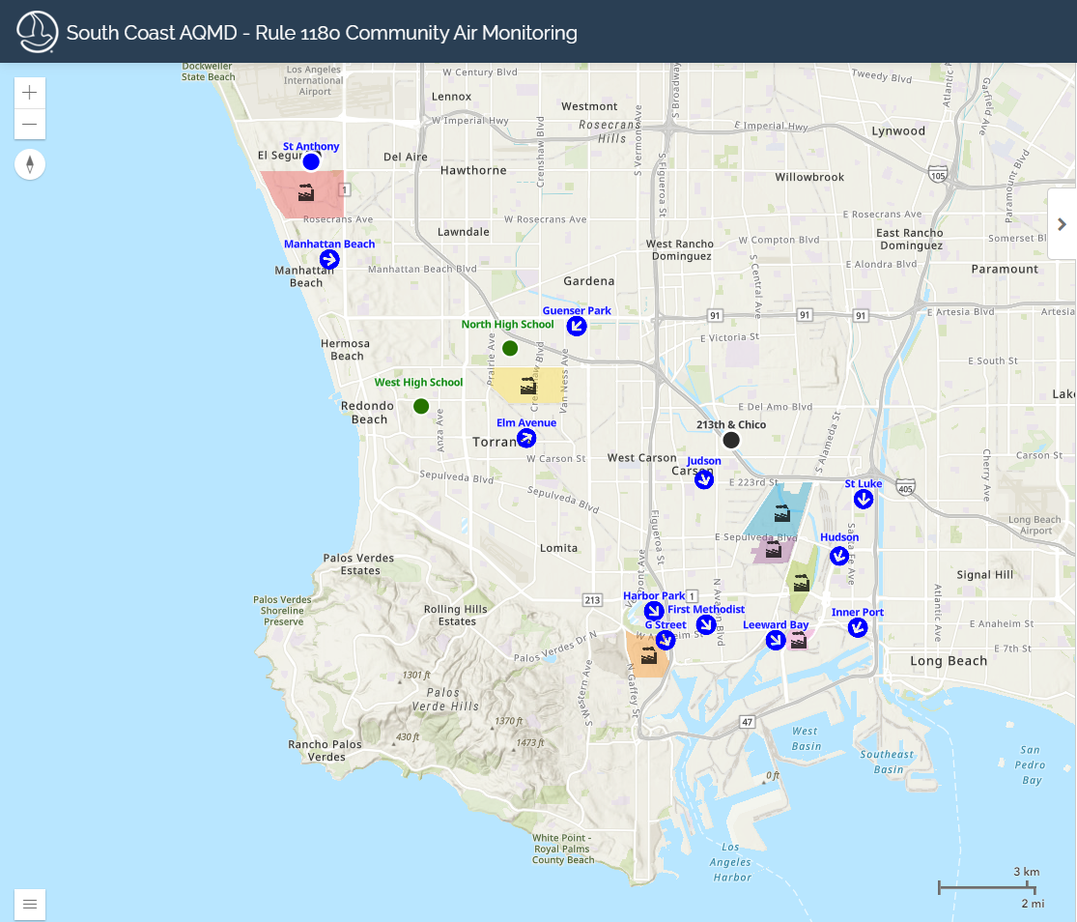
Rule 1180 – Hydrogen Sulfide
Neighborhoods in the surrounding area of oil refineries from the Ports of LA
Air quality regulation at the community level and fenceline
Image source: https://xappprod.aqmd.gov/Rule1180CommunityAirMonitoring/
Notes:
CF_1 uses the "average particle density" for indoor particulate matter and CF_ATM uses the "average particle density" for outdoor particulate matter
PAS = PurpleAir Synoptic data; A pas object is just a large dataframe with 44 data columns and a record for each PurupleAir sensor channel (2 channels per sensor)
PAT = PurpleAir Time Series data; pat contains two dataframes, meta and data. The meta dataframe contains metadata of the selected PurpleAir sensor – this includes non-time series data such as location information, labels, etc. The data dataframe contains datestamped sensor readings of PM2.5, temperature, humidity, and other pertinent sensor data.
Screenshot of R package documentation
Have an objective/aim -- what is the purpose of all of this

Slide 13


Rule 1180 – Hydrogen Sulfide
The infographic was led by EHMATTERS fellow Jennifer Ahumada and Dr. Arbor Quist
Notes:
CF_1 uses the "average particle density" for indoor particulate matter and CF_ATM uses the "average particle density" for outdoor particulate matter
PAS = PurpleAir Synoptic data; A pas object is just a large dataframe with 44 data columns and a record for each PurupleAir sensor channel (2 channels per sensor)
PAT = PurpleAir Time Series data; pat contains two dataframes, meta and data. The meta dataframe contains metadata of the selected PurpleAir sensor – this includes non-time series data such as location information, labels, etc. The data dataframe contains datestamped sensor readings of PM2.5, temperature, humidity, and other pertinent sensor data.
Screenshot of R package documentation
Have an objective/aim -- what is the purpose of all of this

Slide 14
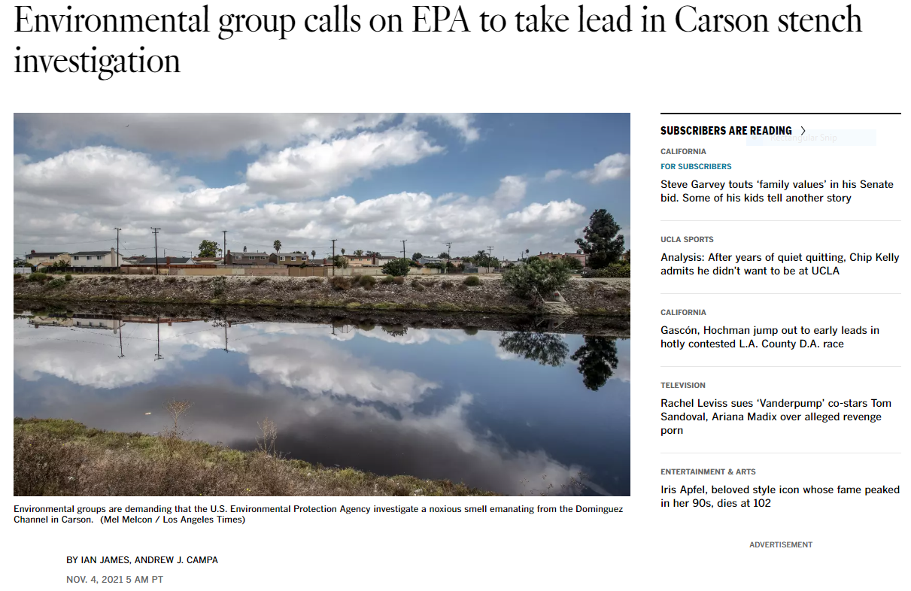
Rule 1180 – Hydrogen Sulfide
Image source: https://www.latimes.com/california/story/2021-11-04/environmentalists-demand-epa-investigate-carson-stench
Notes:
CF_1 uses the "average particle density" for indoor particulate matter and CF_ATM uses the "average particle density" for outdoor particulate matter
PAS = PurpleAir Synoptic data; A pas object is just a large dataframe with 44 data columns and a record for each PurupleAir sensor channel (2 channels per sensor)
PAT = PurpleAir Time Series data; pat contains two dataframes, meta and data. The meta dataframe contains metadata of the selected PurpleAir sensor – this includes non-time series data such as location information, labels, etc. The data dataframe contains datestamped sensor readings of PM2.5, temperature, humidity, and other pertinent sensor data.
Screenshot of R package documentation
Have an objective/aim -- what is the purpose of all of this

Slide 15
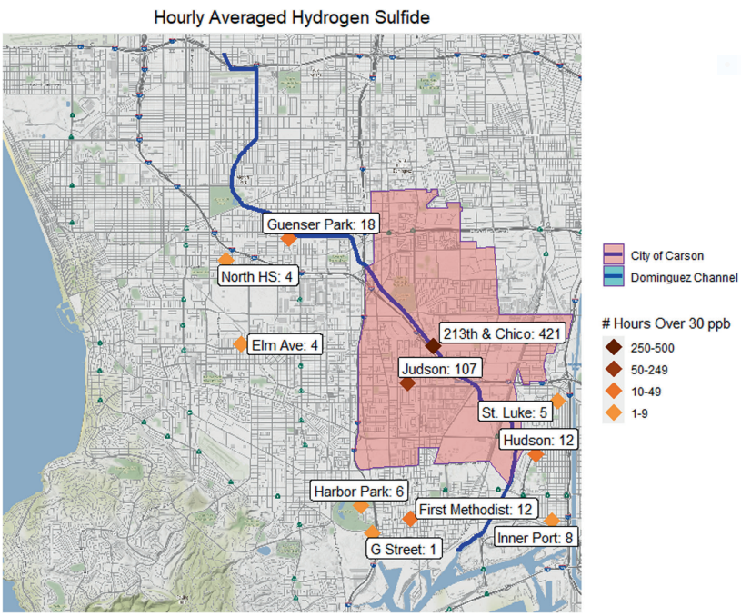
Rule 1180 – Hydrogen Sulfide
California standard for Hydrogen Sulfide H₂S is 30 ppb
H₂S is detectable around 0.1-0.5 ppb
Dr. Quist and Dr. Johnston’s Paper: https://www.nature.com/articles/s41370-023-00561-x#citeas
Notes:
CF_1 uses the "average particle density" for indoor particulate matter and CF_ATM uses the "average particle density" for outdoor particulate matter
PAS = PurpleAir Synoptic data; A pas object is just a large dataframe with 44 data columns and a record for each PurupleAir sensor channel (2 channels per sensor)
PAT = PurpleAir Time Series data; pat contains two dataframes, meta and data. The meta dataframe contains metadata of the selected PurpleAir sensor – this includes non-time series data such as location information, labels, etc. The data dataframe contains datestamped sensor readings of PM2.5, temperature, humidity, and other pertinent sensor data.
Screenshot of R package documentation
Have an objective/aim -- what is the purpose of all of this

Slide 16
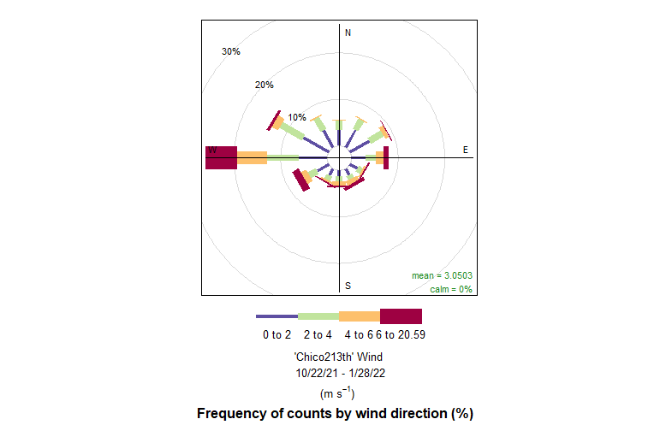
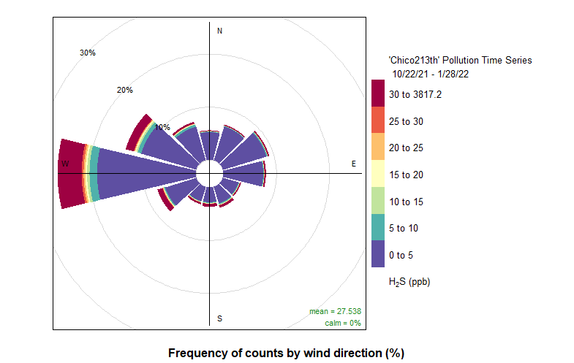
Rule 1180 – Hydrogen Sulfide
Notes:
CF_1 uses the "average particle density" for indoor particulate matter and CF_ATM uses the "average particle density" for outdoor particulate matter
PAS = PurpleAir Synoptic data; A pas object is just a large dataframe with 44 data columns and a record for each PurupleAir sensor channel (2 channels per sensor)
PAT = PurpleAir Time Series data; pat contains two dataframes, meta and data. The meta dataframe contains metadata of the selected PurpleAir sensor – this includes non-time series data such as location information, labels, etc. The data dataframe contains datestamped sensor readings of PM2.5, temperature, humidity, and other pertinent sensor data.
Screenshot of R package documentation
Have an objective/aim -- what is the purpose of all of this

Slide 17

Some Future Directions
Further development of Shiny platform to update data
Further analyses/visualizations of air pollutants
Continue to develop data storage and pipelines into applications

Slide 18
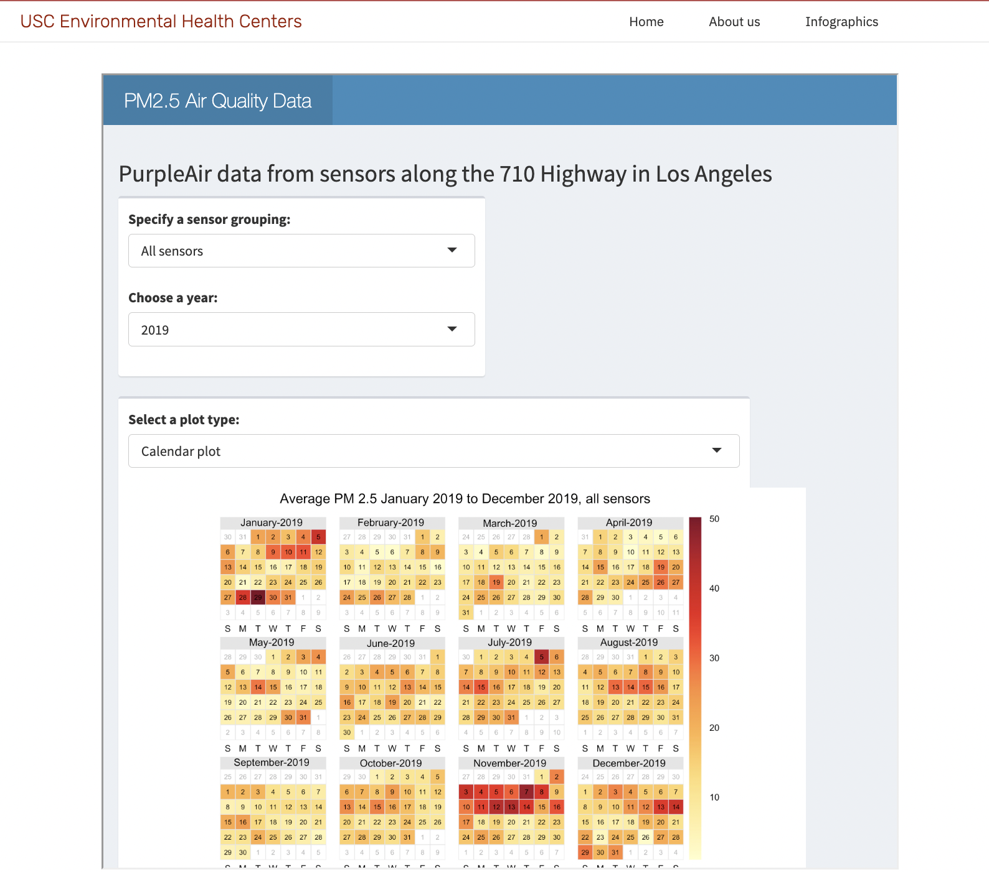
Increasing web-based interactions
R packages 'Shiny' and 'ShinyDashboard'
Create an interactive tool for community groups to easily look through and interpret visualizations
Produced by Claire Bai: https://envhealthcenters.usc.edu/pm-2-5-shiny

Slide 19



Data Storage Options
Easily grow and maintain your database in the cloud or on premise for free!
Connect to interactive tools for community groups to easily look through and interpret visualizations

Slide 20
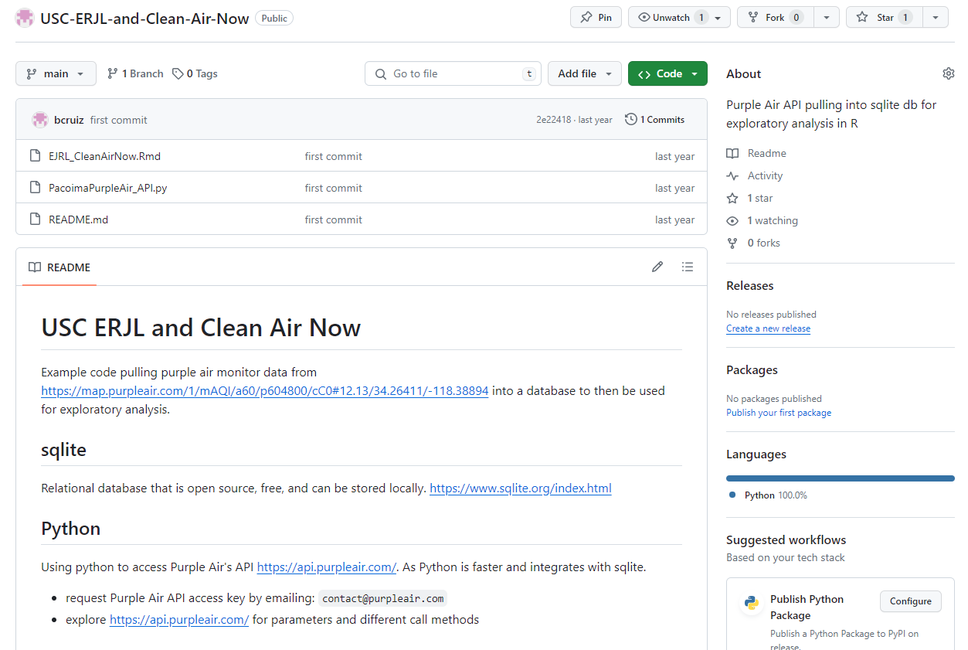
Purple Data Extraction
Summarized tutorial for data extraction by API for PurpleAir
GitHub Tutorial: https://github.com/bcruiz/USC-ERJL-and-Clean-Air-Now

Slide 21


Thank You!
Contact information:
Brandyn Ruiz, bcruiz@usc.edu
Dr. Jill Johnston, jillj@usc.edu
Visit https://envhealthcenters.usc.edu/ and https://ejresearchlab.usc.edu/en/ for more info!

